Slide 1
Satisfiability Modulo Theories (SMT): ideas and applications Università Degli Studi Di Milano Scuola di Dottorato in Informatica, 2010
Leonardo de Moura
Microsoft Research

Slide 2
Linear Arithmetic
Many approaches
Graph-based for difference logic: a – b ≤ 3
Fourier-Motzkin elimination:
Standard Simplex
General Form Simplex

Slide 3
Difference Logic: a – b ≤ 5
Very useful in practice!
Most arithmetical constraints in software verification/analysis are in this fragment.
x := x + 1
x₁ = x₀ + 1
x₁ - x₀ ≤ 1, x₀ - x₁ ≤ -1

Slide 4
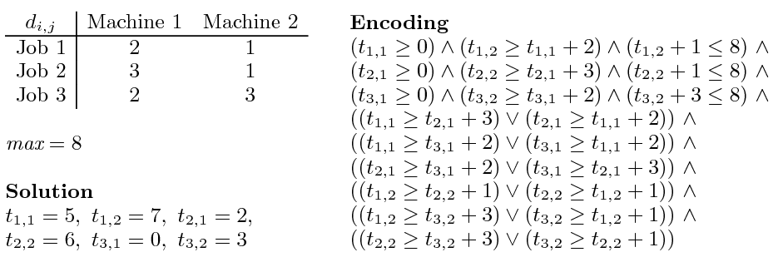
Job shop scheduling

Slide 5
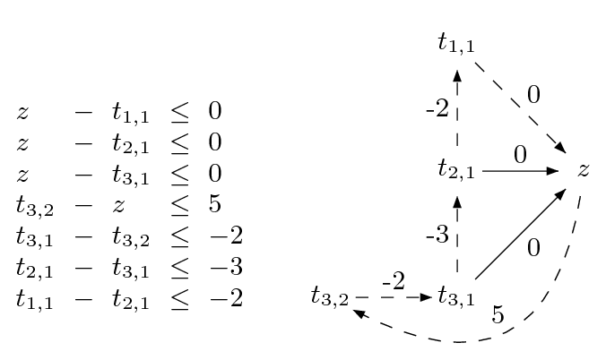
Difference Logic
Chasing negative cycles!
Algorithms based on Bellman-Ford (O(mn)).

Slide 6
Standard Simplex
Many solvers (e.g., ICS, Simplify) are based on the Standard Simplex.
a - d + 2e = 3
b - d = 1
c + d - e = -1
a, b, c, d, e ≥ 0

Slide 7
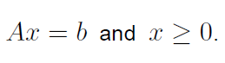
Standard Simplex
Many solvers (e.g., ICS, Simplify) are based on the Standard Simplex.
a - d + 2e = 3
b - d = 1
c + d - e = -1
a, b, c, d, e ≥ 0
a
b
c
d
e
1 0 0 -1 2
0 1 0 -1 0
0 0 1 1 -1
3
1
-1
=

Slide 8
Standard Simplex
Many solvers (e.g., ICS, Simplify) are based on the Standard Simplex.
a - d + 2e = 3
b - d = 1
c + d - e = -1
a, b, c, d, e ≥ 0
We say a,b,c are the basic (or dependent) variables
a
b
c
d
e
1 0 0 -1 2
0 1 0 -1 0
0 0 1 1 -1
3
1
-1
=

Slide 9
Standard Simplex
Many solvers (e.g., ICS, Simplify) are based on the Standard Simplex.
a - d + 2e = 3
b - d = 1
c + d - e = -1
a, b, c, d, e ≥ 0
We say a,b,c are the basic (or dependent) variables
We say d,e are the
non-basic (or non- dependent) variables.
a
b
c
d
e
1 0 0 -1 2
0 1 0 -1 0
0 0 1 1 -1
3
1
-1
=

Slide 10
Standard Simplex
Incrementality: add/remove equations
Slow backtracking
No theory propagation

Slide 11
Fast Linear Arithmetic
Simplex General Form
Algorithm based on the dual simplex
Non redundant proofs
Efficient backtracking
Efficient theory propagation
Support for string inequalities: t > 0
Preprocessing step
Integer problems:
Gomory cuts, Branch & Bound, GCD test

Slide 12
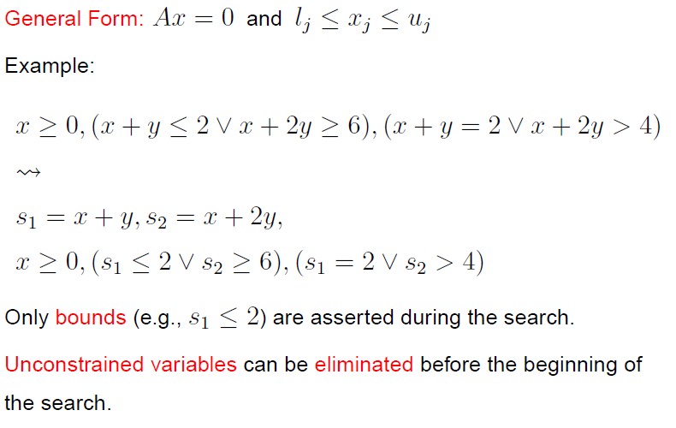
General Form

Slide 13
From Definitions to a Tableau
s₁ ≡ x + y, s₂ ≡ x + 2y

Slide 14
From Definitions to a Tableau
s₁ ≡ x + y, s₂ ≡ x + 2y
s₁ = x + y,
s₂ = x + 2y

Slide 15
From Definitions to a Tableau
s₁ ≡ x + y, s₂ ≡ x + 2y
s₁ = x + y,
s₂ = x + 2y
s₁ - x - y = 0
s₂ - x - 2y = 0

Slide 16
From Definitions to a Tableau
s₁ ≡ x + y, s₂ ≡ x + 2y
s₁ = x + y,
s₂ = x + 2y
s₁ - x - y = 0
s₂ - x - 2y = 0
s₁, s₂ are basic (dependent)
x,y are non-basic

Slide 17
Pivoting
A way to swap a basic with a non-basic variable!
It is just equational reasoning.
Key invariant: a basic variable occurs in only one equation.
Example: swap s₁ and y
s₁ - x - y = 0
s₂ - x - 2y = 0

Slide 18
Pivoting
A way to swap a basic with a non-basic variable!
It is just equational reasoning.
Key invariant: a basic variable occurs in only one equation.
Example: swap s₁ and y
s₁ - x - y = 0
s₂ - x - 2y = 0
-s₁ + x + y = 0
s₂ - x - 2y = 0

Slide 19
Pivoting
A way to swap a basic with a non-basic variable!
It is just equational reasoning.
Key invariant: a basic variable occurs in only one equation.
Example: swap s₁ and y
s₁ - x - y = 0
s₂ - x - 2y = 0
-s₁ + x + y = 0
s₂ - x - 2y = 0
-s₁ + x + y = 0
s₂ - 2s₁ + x = 0

Slide 20
Pivoting
A way to swap a basic with a non-basic variable!
It is just equational reasoning.
Key invariant: a basic variable occurs in only one equation.
Example: swap s₁ and y
It is just substituting equals by equals.
s₁ - x - y = 0
s₂ - x - 2y = 0
-s₁ + x + y = 0
s₂ - x - 2y = 0
-s₁ + x + y = 0
s₂ - 2s₁ + x = 0

Slide 21
Pivoting
Definition:
An assignment (model) is a mapping from variables to values
A way to swap a basic with a non-basic variable!
It is just equational reasoning.
Key invariant: a basic variable occurs in only one equation.
Example: swap s₁ and y
It is just substituting equals by equals.
s₁ - x - y = 0
s₂ - x - 2y = 0
-s₁ + x + y = 0
s₂ - x - 2y = 0
Key Property:
If an assignment satisfies the equations before a pivoting step, then it will also satisfy them after!
-s₁ + x + y = 0
s₂ - 2s₁ + x = 0

Slide 22
Pivoting
Definition:
An assignment (model) is a mapping from variables to values
A way to swap a basic with a non-basic variable!
It is just equational reasoning.
Key invariant: a basic variable occurs in only one equation.
Example: swap s₂ and y
It is just substituting equals by equals.
s₁ - x - y = 0
s₂ - x - 2y = 0
Example:
M(x) = 1
M(y) = 1
M(s₁) = 2
M(s₂) = 3
-s₁ + x + y = 0
s₂ - x - 2y = 0
Key Property:
If an assignment satisfies the equations before a pivoting step, then it will also satisfy them after!
-s₁ + x + y = 0
s₂ - 2s₁ + x = 0

Slide 23
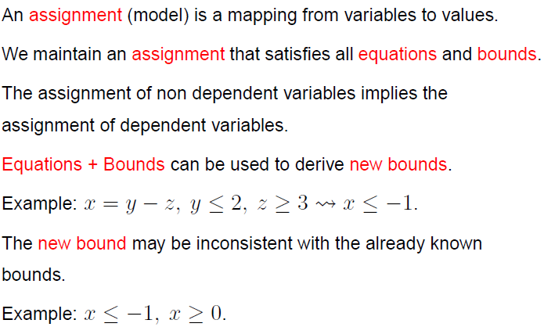
Equations + Bounds + Assignment

Slide 24
“Repairing Models”
If the assignment of a non-basic variable does not satisfy a bound, then fix it and propagate the change to all dependent variables.
a = c – d
b = c + d
M(a) = 0
M(b) = 0
M(c) = 0
M(d) = 0
1 ≤ c
a = c – d
b = c + d
M(a) = 1
M(b) = 1
M(c) = 1
M(d) = 0
1 ≤ c

Slide 25
“Repairing Models”
If the assignment of a non-basic variable does not satisfy a bound, then fix it and propagate the change to all dependent variables. Of course, we may introduce new “problems”.
a = c – d
b = c + d
M(a) = 0
M(b) = 0
M(c) = 0
M(d) = 0
1 ≤ c
a ≤ 0
a = c – d
b = c + d
M(a) = 1
M(b) = 1
M(c) = 1
M(d) = 0
1 ≤ c
a ≤ 0

Slide 26
“Repairing Models”
If the assignment of a basic variable does not satisfy a bound, then pivot it, fix it, and propagate the change to its new dependent variables.
a = c – d
b = c + d
M(a) = 0
M(b) = 0
M(c) = 0
M(d) = 0
1 ≤ a
c = a + d
b = a + 2d
M(a) = 0
M(b) = 0
M(c) = 0
M(d) = 0
1 ≤ a
c = a + d
b = a + 2d
M(a) = 1
M(b) = 1
M(c) = 1
M(d) = 0
1 ≤ a

Slide 27
“Repairing Models”
Sometimes, a model cannot be repaired. It is pointless to pivot.
a = b – c
a ≤ 0, 1 ≤ b, c ≤ 0
M(a) = 1
M(b) = 1
M(c) = 0
The value of M(a) is too big. We can reduce it by:
reducing M(b)
not possible b is at lower bound
increasing M(c)
not possible c is at upper bound

Slide 28
“Repairing Models”
Extracting proof from failed repair attempts is easy.
s₁ ≡ a + d, s₂ ≡ c + d
a = s₁ – s₂ + c
a ≤ 0, 1 ≤ s₁, s₂ ≤ 0, 0 ≤ c
M(a) = 1
M(s₁) = 1
M(s₂) = 0
M(c) = 0

Slide 29
“Repairing Models”
Extracting proof from failed repair attempts is easy.
s₁ ≡ a + d, s₂ ≡ c + d
a = s₁ – s₂ + c
a ≤ 0, 1 ≤ s₁, s₂ ≤ 0, 0 ≤ c
M(a) = 1
M(s₁) = 1
M(s₂) = 0
M(c) = 0
{ a ≤ 0, 1 ≤ s₁, s₂ ≤ 0, 0 ≤ c } is inconsistent

Slide 30
“Repairing Models”
Extracting proof from failed repair attempts is easy.
s₁ ≡ a + d, s₂ ≡ c + d
a = s₁ – s₂ + c
a ≤ 0, 1 ≤ s₁, s₂ ≤ 0, 0 ≤ c
M(a) = 1
M(s₁) = 1
M(s₂) = 0
M(c) = 0
{ a ≤ 0, 1 ≤ s₁, s₂ ≤ 0, 0 ≤ c } is inconsistent
{ a ≤ 0, 1 ≤ a + d, c + d ≤ 0, 0 ≤ c } is inconsistent

Slide 31
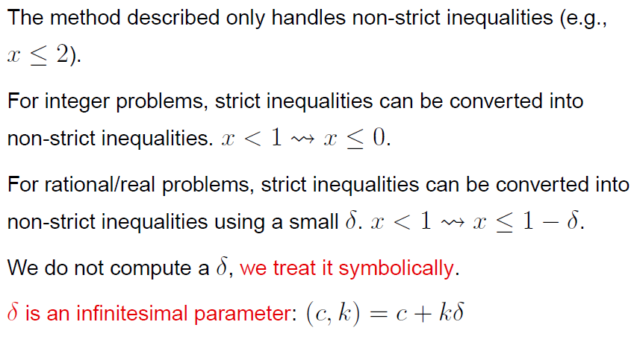
Strict Inequalities

Slide 32
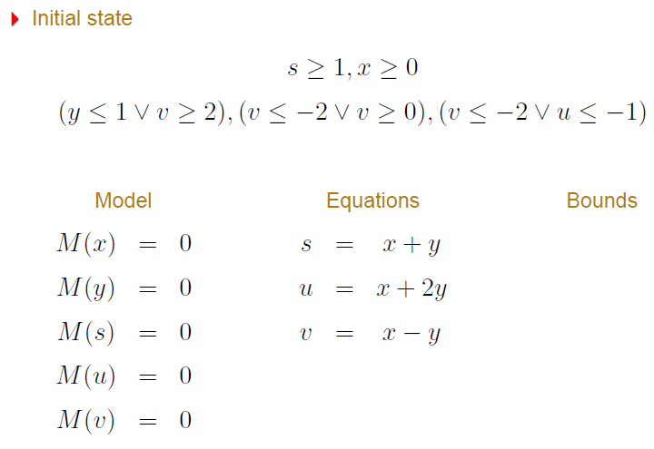
Example

Slide 33
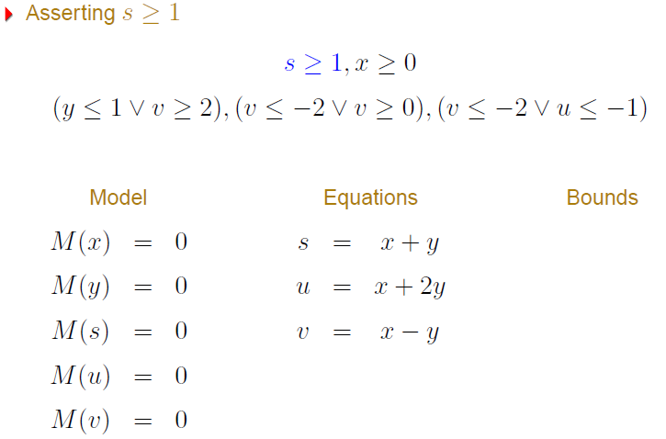
Example

Slide 34
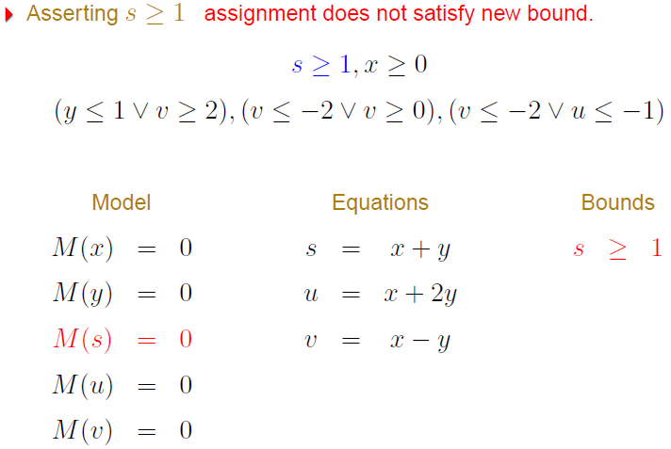
Example

Slide 35
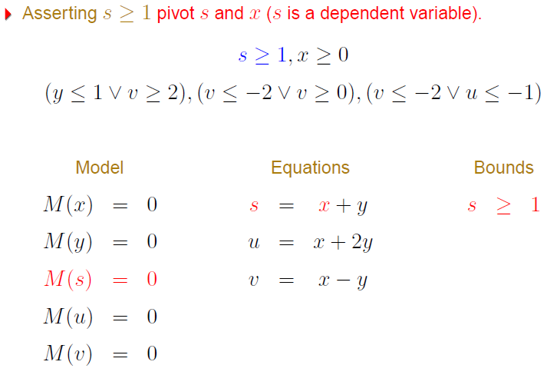
Example

Slide 36
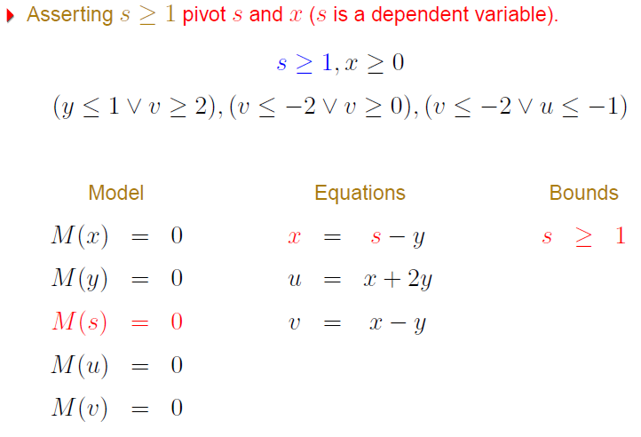
Example

Slide 37
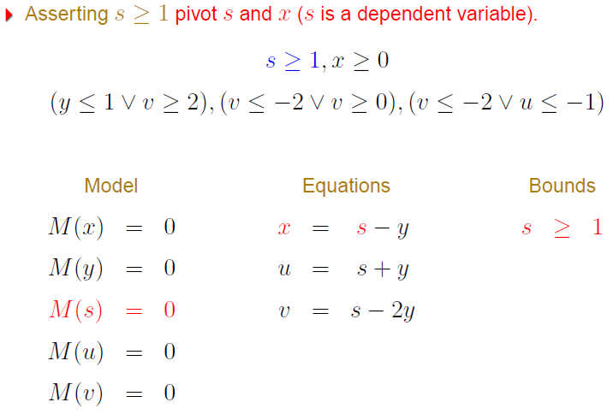
Example

Slide 38
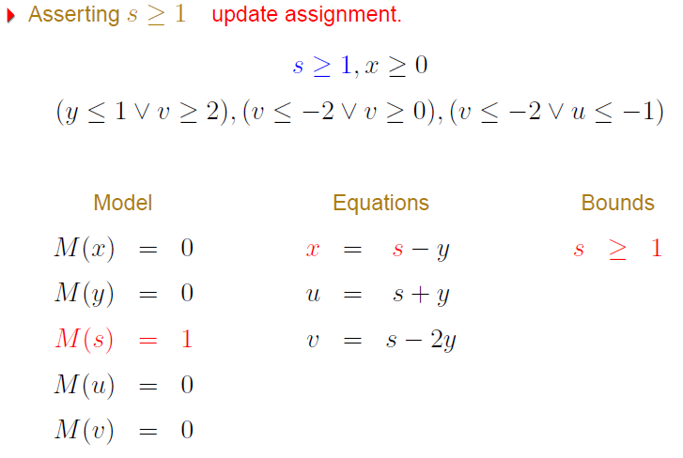
Example

Slide 39
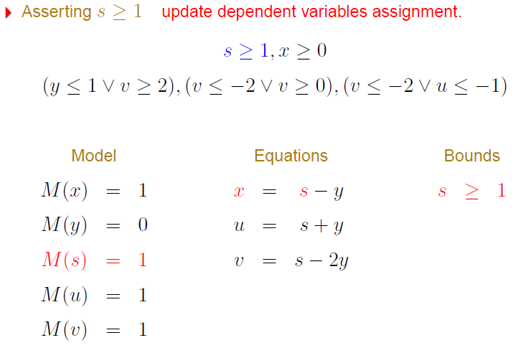
Example

Slide 40
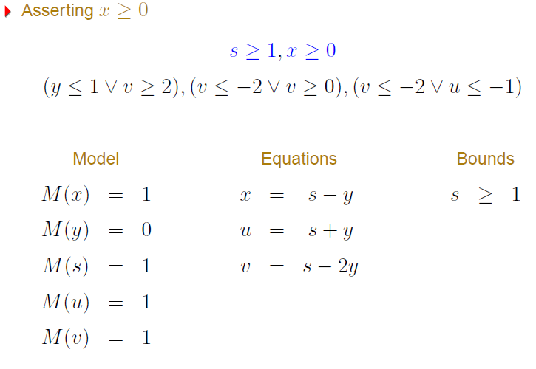
Example

Slide 41
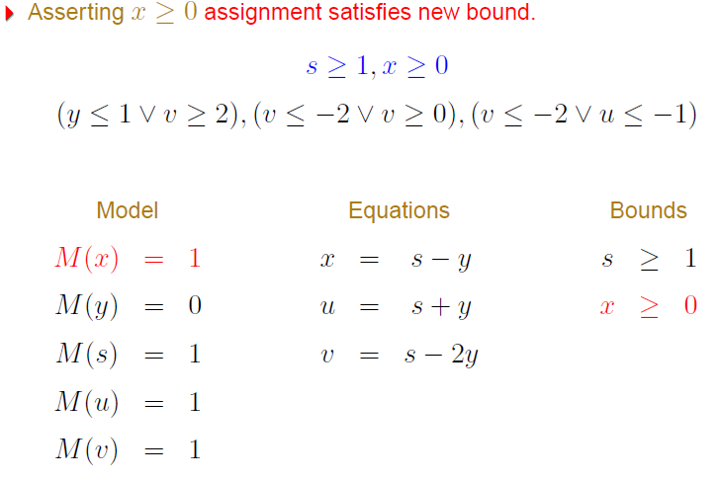
Example

Slide 42
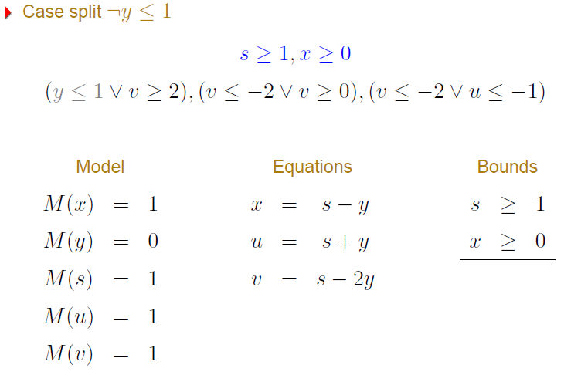
Example

Slide 43
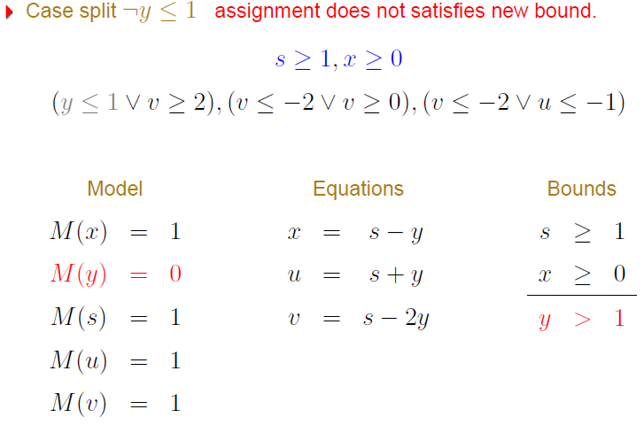
Example

Slide 44
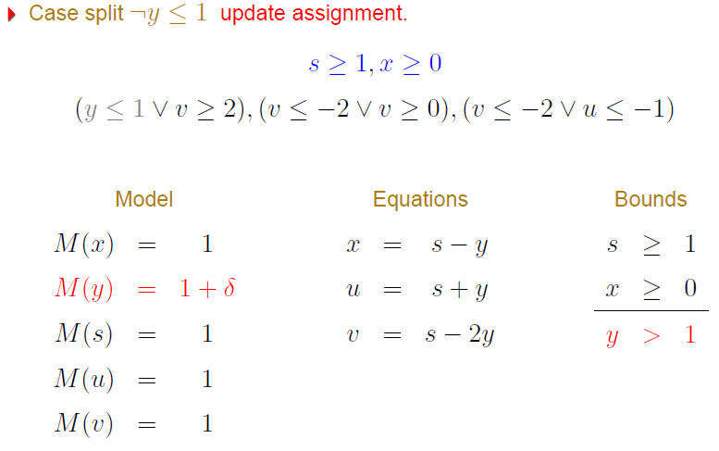
Example

Slide 45
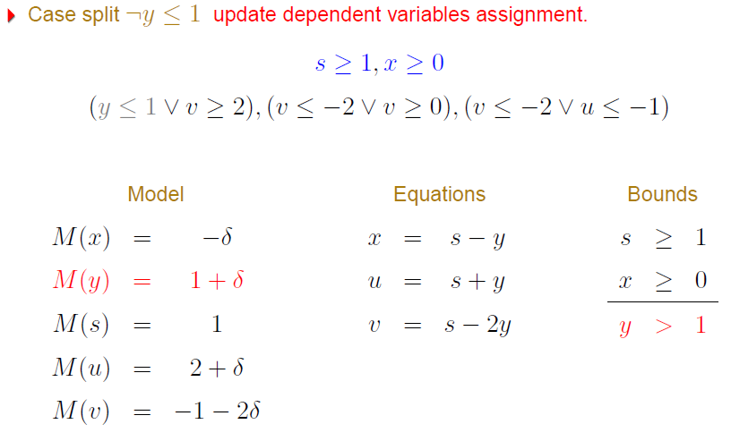
Example

Slide 46
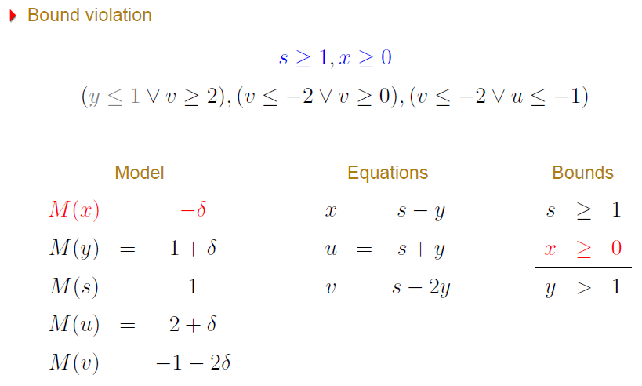
Example

Slide 47
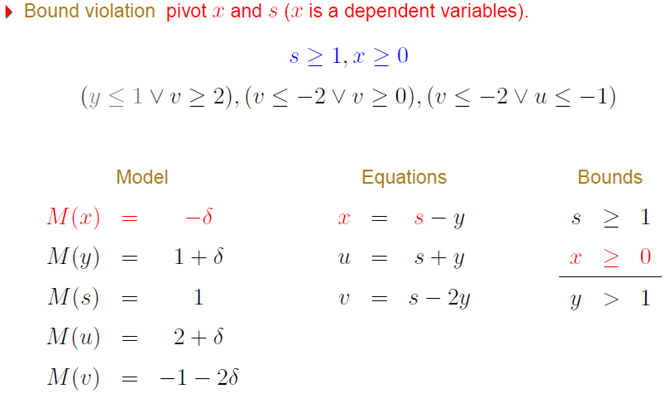
Example

Slide 48
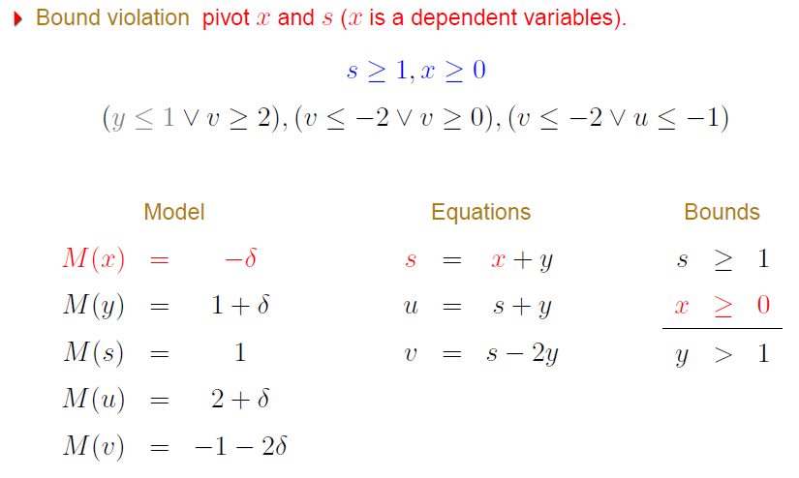
Example

Slide 49
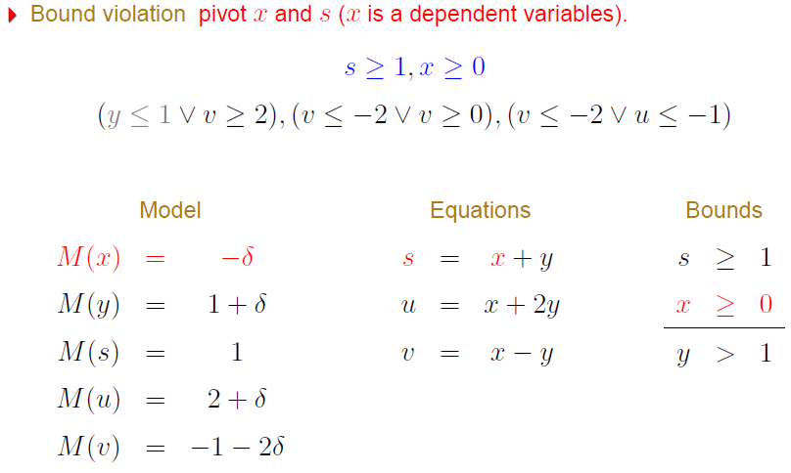
Example

Slide 50
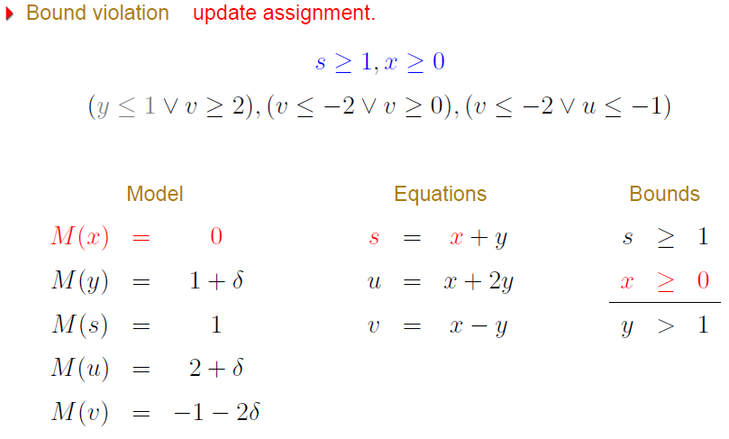
Example

Slide 51
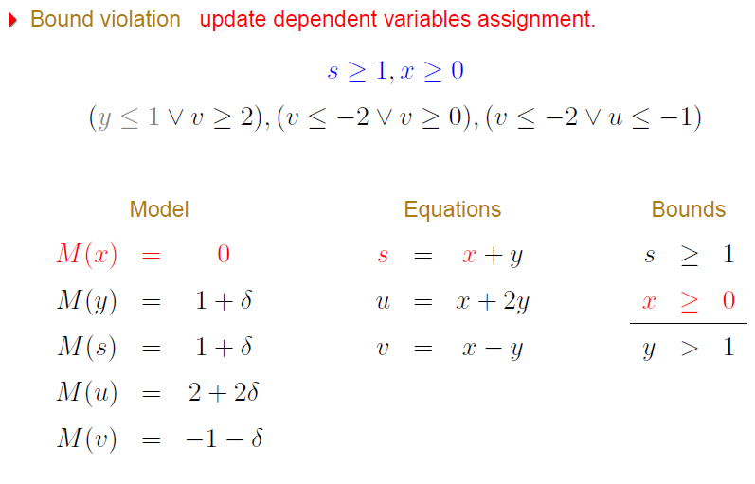
Example

Slide 52
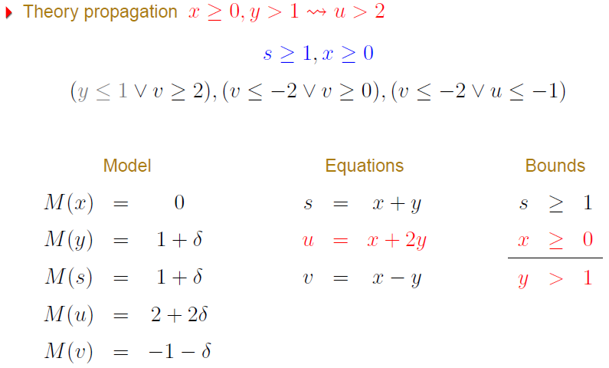
Example

Slide 53
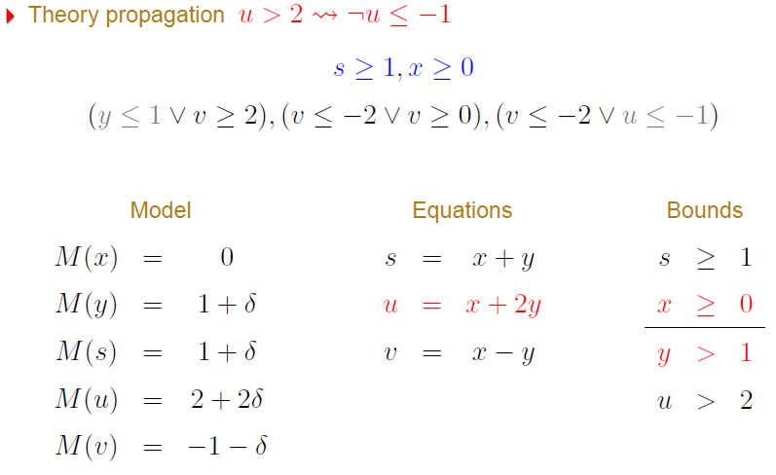
Example

Slide 54
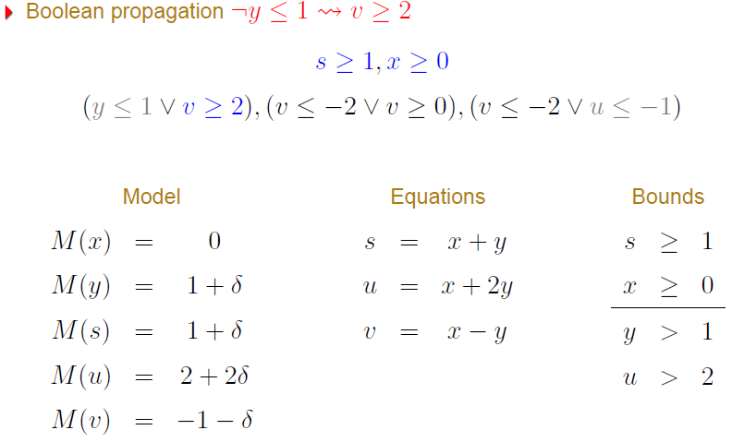
Example

Slide 55
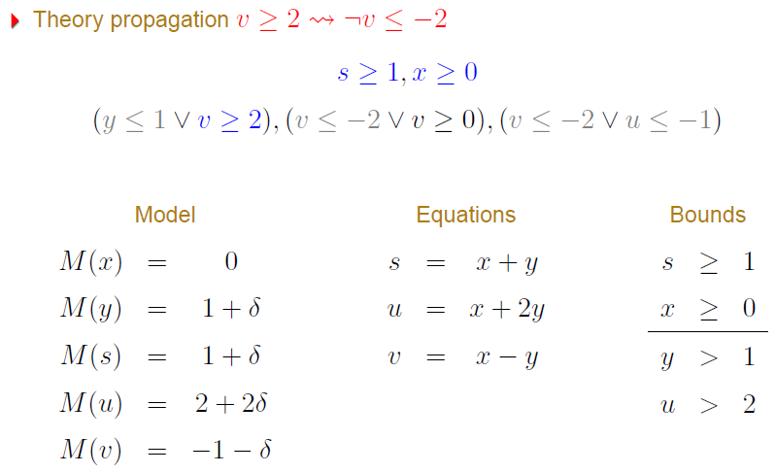
Example

Slide 56
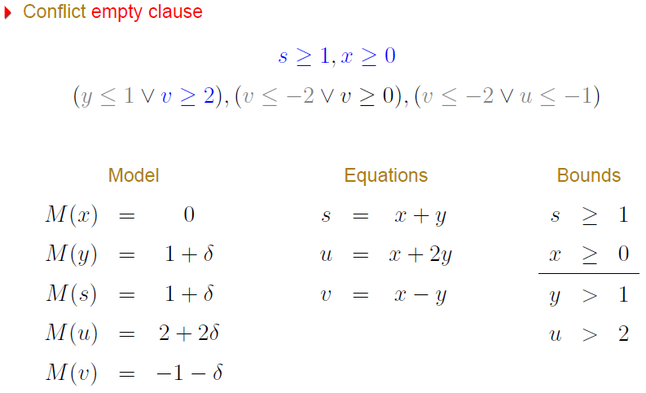
Example

Slide 57
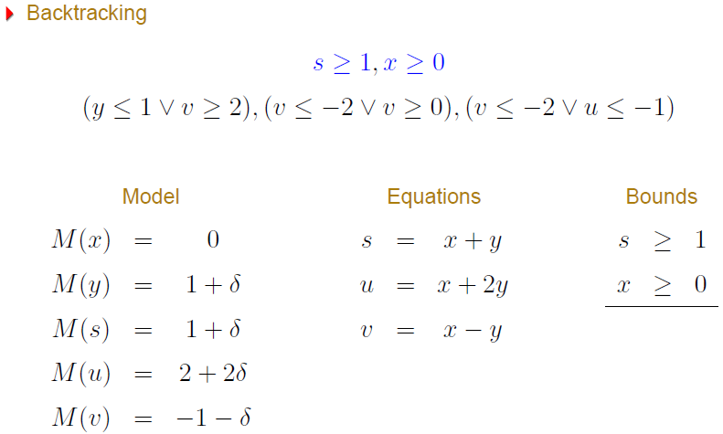
Example

Slide 58
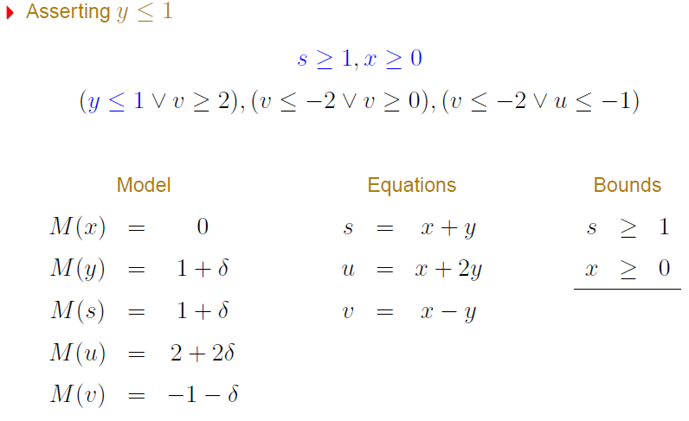
Example

Slide 59
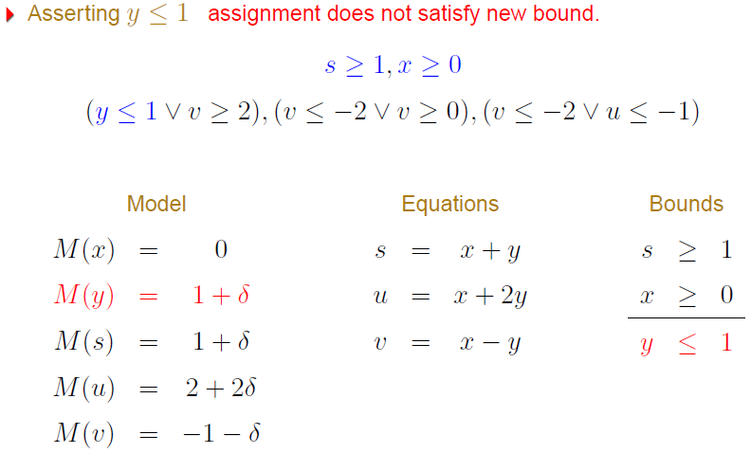
Example

Slide 60
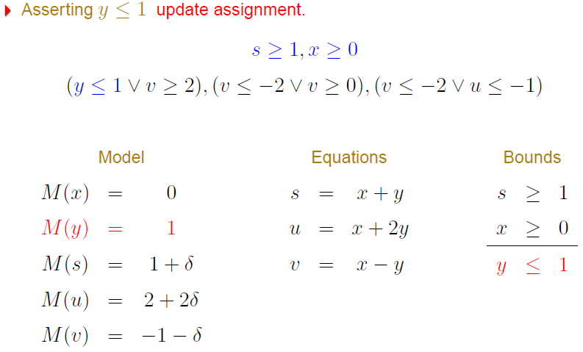
Example

Slide 61
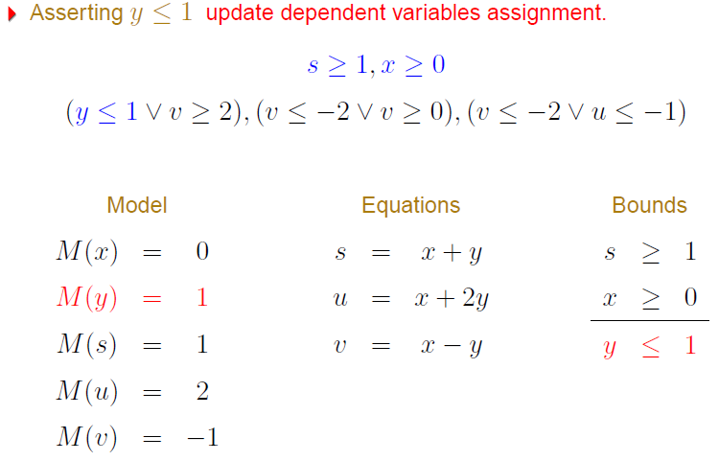
Example

Slide 62
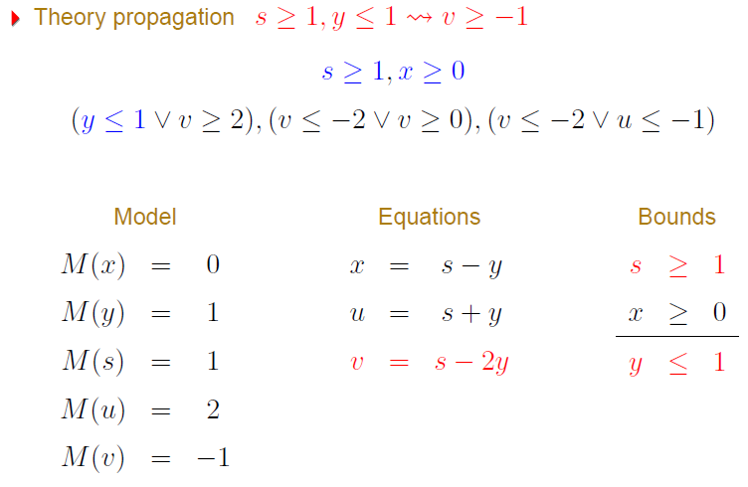
Example

Slide 63
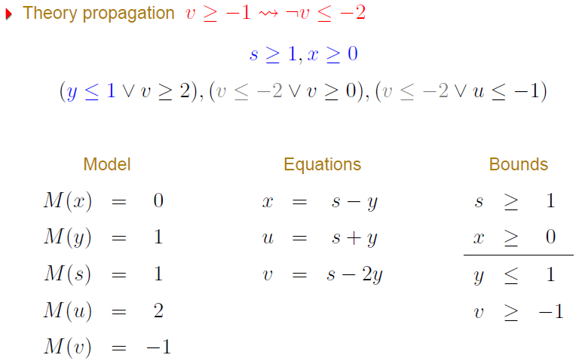
Example

Slide 64
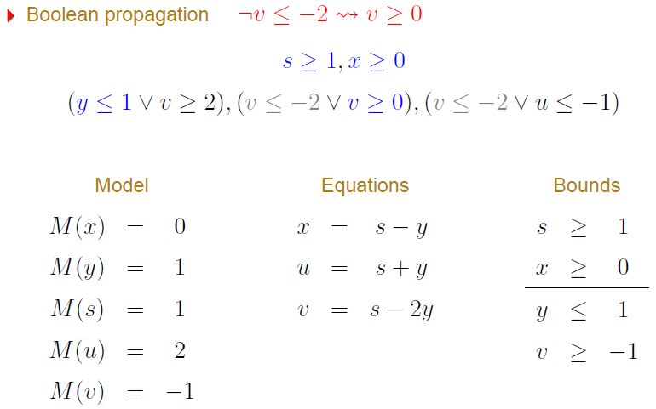
Example

Slide 65
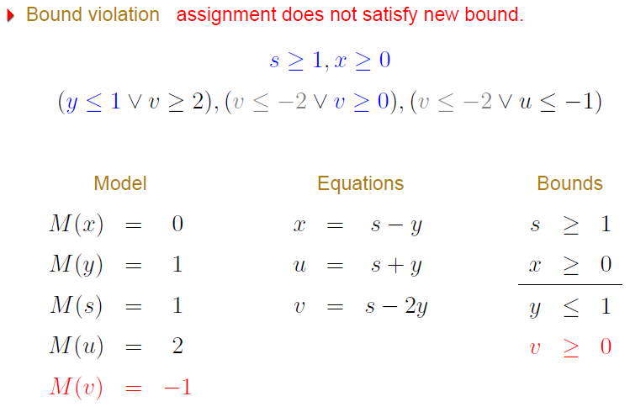
Example

Slide 66
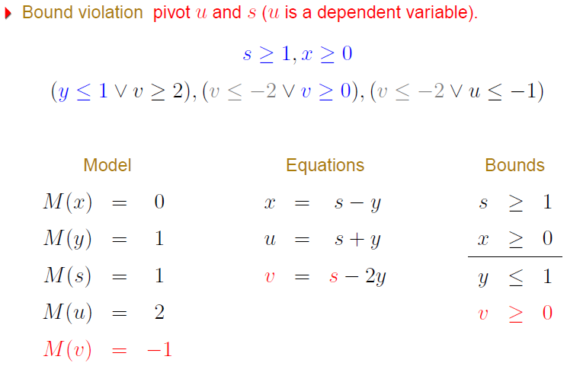
Example

Slide 67
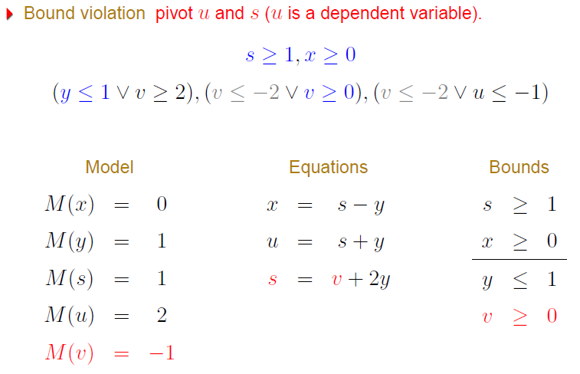
Example

Slide 68
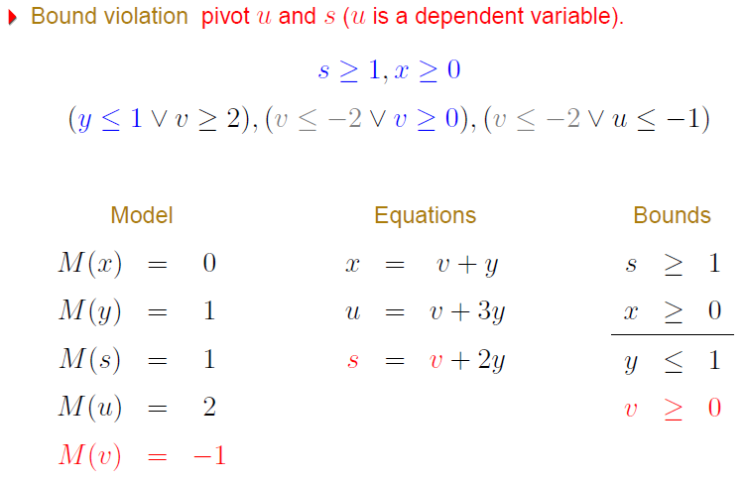
Example

Slide 69
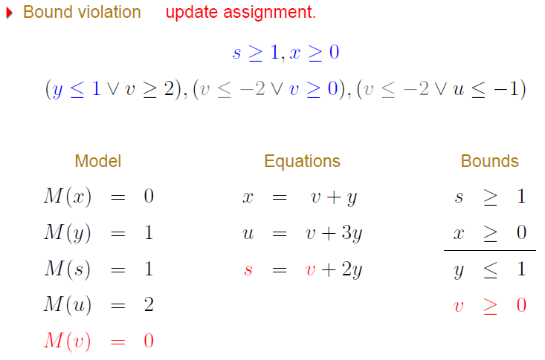
Example

Slide 70
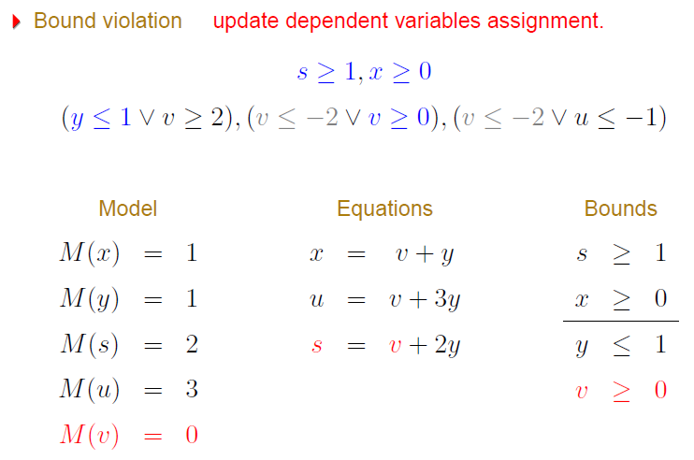
Example

Slide 71
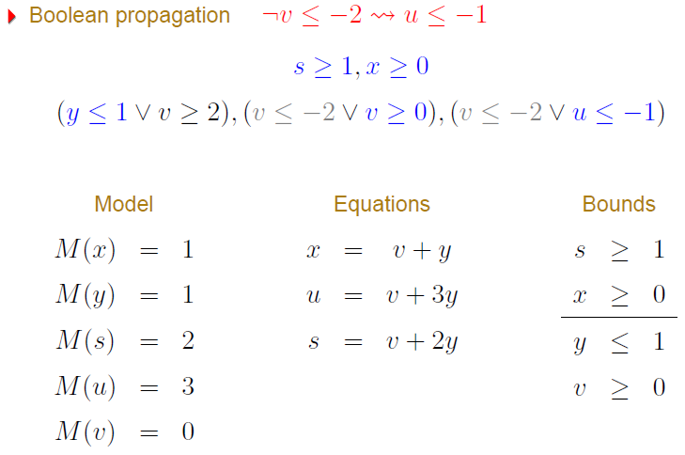
Example

Slide 72
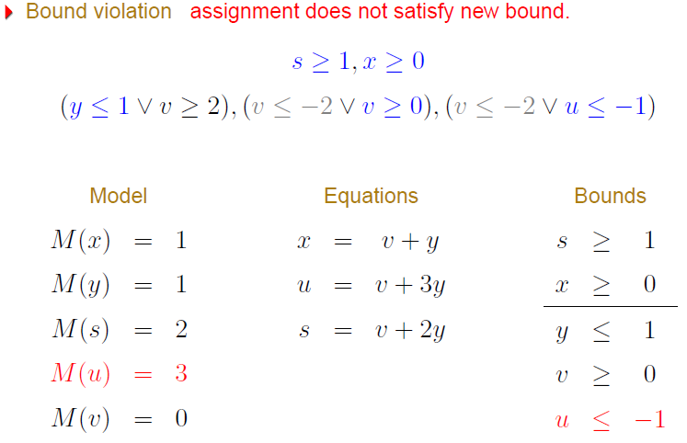
Example

Slide 73
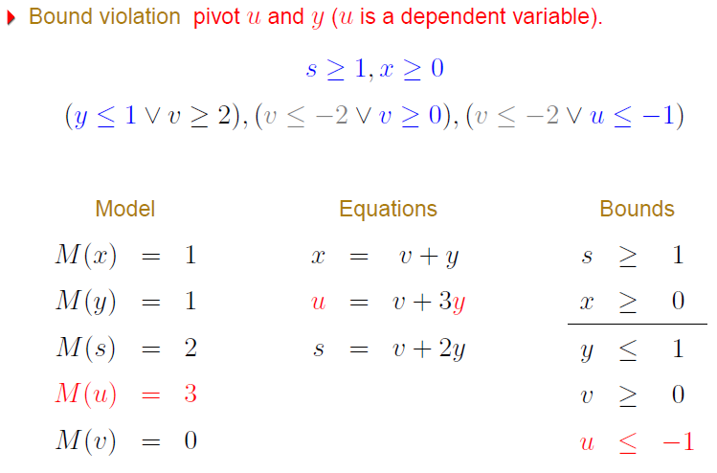
Example

Slide 74
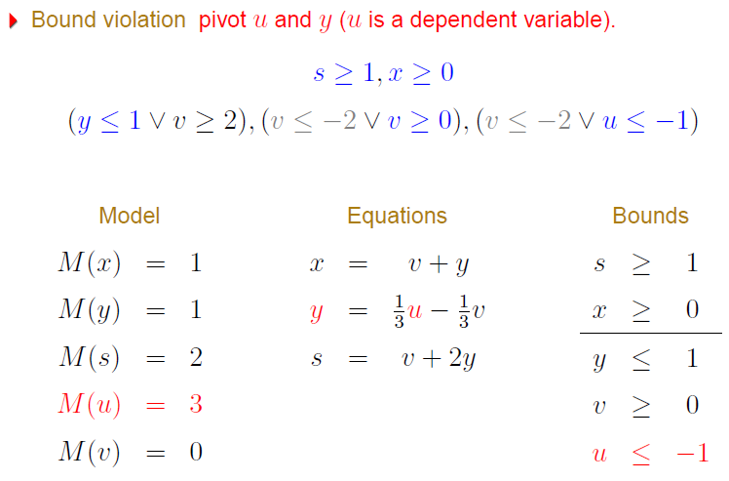
Example

Slide 75
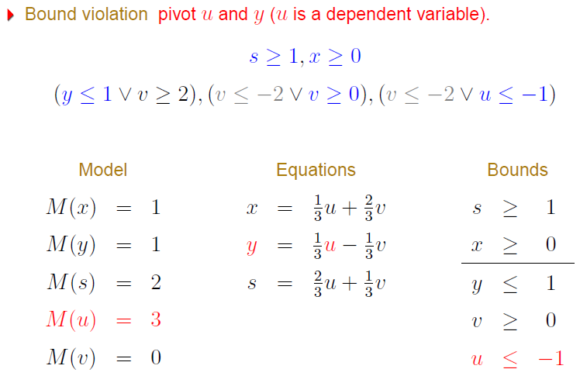
Example

Slide 76

Example

Slide 77

Example

Slide 78

Example

Slide 79

Example

Slide 80

Example

Slide 81

Example

Slide 82

Example

Slide 83

Example

Slide 84

Example

Slide 85
Correctness
Completeness: trivial
Soundness: also trivial
Termination: non trivial.
We cannot choose arbitrary variable to pivot.
Assume the variables are ordered.
Bland’s rule: select the smallest basic variable c that does not satisfy its bounds, then select the smallest non-basic in the row of c that can be used for pivoting.
Too technical.
Uses the fact that a tableau has a finite number of configurations. Then, any infinite trace will have cycles.

Slide 86
Data-structures
Array of rows (equations).
Each row is a dynamic array of tuples:
(coefficient, variable, pos_in_occs, is_dead)
Each variable x has a “set” (dynamic array) of occurrences:
(row_idx, pos_in_row, is_dead)
Each variable x has a “field” row[x]
row[x] is -1 if x is non basic
otherwise, row[x] contains the idx of the row containing x
Each variable x has “fields”: lower[x], upper[x], and value[x]

Slide 87
Data-structures
rows: array of rows (equations).
Each row is a dynamic array of tuples:
(coefficient, variable, pos_in_occs, is_dead)
occs[x]: Each variable x has a “set” (dynamic array) of occurrences:
(row_idx, pos_in_row, is_dead)
row[x]:
row[x] is -1 if x is non basic
otherwise, row[x] contains the idx of the row containing x
Other “fields”: lower[x], upper[x], and value[x]
atoms[x]: atoms (assigned/unassigned) that contains x

Slide 88
Data-structures
rows = [
[(1, a, 0, t), (-1, s₁, 0, t), (1, s₂, 1, t), (1, c, 0, t)],
[(1,b, 0, t), (-1, c, 1, t), (1, s₂, 2, t)] ]
occs[a] = [(0, 0, f)]
occs[b] = [(1,0,f)]
occs[c] = [(0,3,f), (1,1,f)]
occs[s₁] = [(0,1,f)]
occs[s₂] = [(0,0,t), (0,2,f), (1,2,f)]
row[a] = 0, row[b] = 1, row[c] = -1, …
upper[a] = 0, lower[s₁] = 1
atoms[a] = {p₁}, atoms[s₁] = {p₂}, …
s₁ ≡ a + b, s₂ ≡ c – b
p₁ ≡ a ≤ 0, p₂ ≡ 1 ≤ s₁, p₃ ≡ 1 ≤ s₂
p₁, p₂ were already assigned
a - s₁ + s₂ + c = 0
b- c + s₂ = 0
a ≤ 0, 1 ≤ s₁
M(a) = 0 value[a] = 0
M(b) = -1 value[a] = -1
M(c) = 0 value[c] = 0
M(s₁) = 1 value[s₁] = 1
M(s₂) = 1 value[s₂] = 1

Slide 89
Combining Theories
In practice, we need a combination of theories.
b + 2 = c and f(read(write(a,b,3), c-2)) ≠ f(c-b+1)
A theory is a set (potentially infinite) of first-order sentences.
Main questions:
Is the union of two theories T1 ∪ T2 consistent?
Given a solvers for T1 and T2, how can we build a solver for
T1 ∪ T2?

Slide 90
Disjoint Theories
Two theories are disjoint if they do not share function/constant and predicate symbols.
= is the only exception.
Example:
The theories of arithmetic and arrays are disjoint.
Arithmetic symbols: {0, -1, 1, -2, 2, …, +, -, *, >, <, ≥, ≤}
Array symbols: { read, write }

Slide 91
Purification
It is a different name for our “naming” subterms procedure.
b + 2 = c, f(read(write(a,b,3), c-2)) ≠ f(c-b+1)
b + 2 = c, v₆ ≠ v₇
v₁ ≡ 3, v₂ ≡ write(a, b, v₁), v₃ ≡ c-2, v₄ ≡ read(v₂, v₃),
v₅ ≡ c-b+1, v₆ ≡ f(v₄), v₇ ≡ f(v₅)

Slide 92
Purification
It is a different name for our “naming” subterms procedure.
b + 2 = c, f(read(write(a,b,3), c-2)) ≠ f(c-b+1)
b + 2 = c, v₆ ≠ v₇
v₁ ≡ 3, v₂ ≡ write(a, b, v₁), v₃ ≡ c-2, v₄ ≡ read(v₂, v₃),
v₅ ≡ c-b+1, v₆ ≡ f(v₄), v₇ ≡ f(v₅)
b + 2 = c, v₁ ≡ 3, v₃ ≡ c-2, v₅ ≡ c-b+1,
v₂ ≡ write(a, b, v₁), v₄ ≡ read(v₂, v₃),
v₆ ≡ f(v₄), v₇ ≡ f(v₅), v₆ ≠ v₇

Slide 93
Stably Infinite Theories
A theory is stably infinite if every satisfiable QFF is satisfiable in an infinite model.
EUF and arithmetic are stably infinite.
Bit-vectors are not.

Slide 94
Important Result
The union of two consistent, disjoint, stably infinite theories is consistent.

Slide 95
Convexity
A theory T is convex iff
for all finite sets S of literals and
for all a₁ = b₁∨ … ∨ a_{n} = b_{n}
S implies a₁ = b₁∨ … ∨ a_{n} = b_{n}
iff
S implies a_{i} = b_{i} for some 1 ≤ i ≤ n

Slide 96
Convexity: Results
Every convex theory with non trivial models is stably infinite.
All Horn equational theories are convex.
formulas of the form s₁ ≠ r₁∨ … ∨ s_{n} ≠ r_{n} ∨ t = t’
Linear rational arithmetic is convex.

Slide 97
Convexity: Negative Results
Linear integer arithmetic is not convex
1 ≤ a ≤ 2, b = 1, c = 2 implies a = b ∨ a = c
Nonlinear arithmetic
a² = 1, b = 1, c = -1 implies a = b ∨ a = c
Theory of bit-vectors
Theory of arrays
c₁ = read(write(a, i, c₂), j), c₃ = read(a, j)
implies c₁ = c₂ ∨ c₁ = c₃

Slide 98
Combination of non-convex theories
EUF is convex (O(n log n))
IDL is non-convex (O(nm))
EUF ∪ IDL is NP-Complete
Reduce 3CNF to EUF ∪ IDL
For each boolean variable p_{i} add 0 ≤ a_{i} ≤ 1
For each clause p₁ ∨ ¬p₂ ∨ p₃ add
f(a₁, a₂, a₃) ≠ f(0, 1, 0)

Slide 99
Combination of non-convex theories
EUF is convex (O(n log n))
IDL is non-convex (O(nm))
EUF ∪ IDL is NP-Complete
Reduce 3CNF to EUF ∪ IDL
For each boolean variable p_{i} add 0 ≤ a_{i} ≤ 1
For each clause p₁ ∨ ¬p₂ ∨ p₃ add
f(a₁, a₂, a₃) ≠ f(0, 1, 0)
implies
a₁ ≠ 0 ∨ a₂ ≠ 1 ∨ a₃ ≠ 0

Slide 100

Nelson-Oppen Combination

Slide 101

Nelson-Oppen Combination

Slide 102

Soundness

Slide 103

Completeness

Slide 104

NO deterministic procedure (for convex theories)

Slide 105

NO deterministic procedure Completeness

Slide 106
NO procedure: Example
b + 2 = c, f(read(write(a,b,3), c-2)) ≠ f(c-b+1)
Arithmetic
b + 2 = c,
v₁ ≡ 3,
v₃ ≡ c-2,
v₅ ≡ c-b+1
Arrays
v₂ ≡ write(a, b, v₁), v₄ ≡ read(v₂, v₃)
EUF
v₆ ≡ f(v₄),
v₇ ≡ f(v₅),
v₆ ≠ v₇

Slide 107
NO procedure: Example
b + 2 = c, f(read(write(a,b,3), c-2)) ≠ f(c-b+1)
Arithmetic
b + 2 = c,
v₁ ≡ 3,
v₃ ≡ c-2,
v₅ ≡ c-b+1
Arrays
v₂ ≡ write(a, b, v₁), v₄ ≡ read(v₂, v₃)
EUF
v₆ ≡ f(v₄),
v₇ ≡ f(v₅),
v₆ ≠ v₇
Substituting c

Slide 108
NO procedure: Example
b + 2 = c, f(read(write(a,b,3), c-2)) ≠ f(c-b+1)
Arithmetic
b + 2 = c,
v₁ ≡ 3,
v₃ ≡ b,
v₅ ≡ 3
Arrays
v₂ ≡ write(a, b, v₁), v₄ ≡ read(v₂, v₃),
EUF
v₆ ≡ f(v₄),
v₇ ≡ f(v₅),
v₆ ≠ v₇
Propagating v₃ = b

Slide 109
NO procedure: Example
b + 2 = c, f(read(write(a,b,3), c-2)) ≠ f(c-b+1)
Arithmetic
b + 2 = c,
v₁ ≡ 3,
v₃ ≡ b,
v₅ ≡ 3
Arrays
v₂ ≡ write(a, b, v₁), v₄ ≡ read(v₂, v₃),
v₃ = b
EUF
v₆ ≡ f(v₄),
v₇ ≡ f(v₅),
v₆ ≠ v₇,
v₃ = b
Deducing v₄ = v₁

Slide 110
NO procedure: Example
b + 2 = c, f(read(write(a,b,3), c-2)) ≠ f(c-b+1)
Arithmetic
b + 2 = c,
v₁ ≡ 3,
v₃ ≡ b,
v₅ ≡ 3
Arrays
v₂ ≡ write(a, b, v₁), v₄ ≡ read(v₂, v₃),
v₃ = b,
v₄ = v₁
EUF
v₆ ≡ f(v₄),
v₇ ≡ f(v₅),
v₆ ≠ v₇,
v₃ = b
Propagating v₄ = v₁

Slide 111
NO procedure: Example
b + 2 = c, f(read(write(a,b,3), c-2)) ≠ f(c-b+1)
Arithmetic
b + 2 = c,
v₁ ≡ 3,
v₃ ≡ b,
v₅ ≡ 3,
v₄ = v₁
Arrays
v₂ ≡ write(a, b, v₁), v₄ ≡ read(v₂, v₃),
v₃ = b,
v₄ = v₁
EUF
v₆ ≡ f(v₄),
v₇ ≡ f(v₅),
v₆ ≠ v₇,
v₃ = b,
v₄ = v₁
Propagating v₅ = v₁

Slide 112
NO procedure: Example
b + 2 = c, f(read(write(a,b,3), c-2)) ≠ f(c-b+1)
Arithmetic
b + 2 = c,
v₁ ≡ 3,
v₃ ≡ b,
v₅ ≡ 3,
v₄ = v₁
Arrays
v₂ ≡ write(a, b, v₁), v₄ ≡ read(v₂, v₃),
v₃ = b,
v₄ = v₁
EUF
v₆ ≡ f(v₄),
v₇ ≡ f(v₅),
v₆ ≠ v₇,
v₃ = b,
v₄ = v₁,
v₅ = v₁
Congruence: v₆ = v₇

Slide 113
NO procedure: Example
b + 2 = c, f(read(write(a,b,3), c-2)) ≠ f(c-b+1)
Arithmetic
b + 2 = c,
v₁ ≡ 3,
v₃ ≡ b,
v₅ ≡ 3,
v₄ = v₁
Arrays
v₂ ≡ write(a, b, v₁), v₄ ≡ read(v₂, v₃),
v₃ = b,
v₄ = v₁
EUF
v₆ ≡ f(v₄),
v₇ ≡ f(v₅),
v₆ ≠ v₇,
v₃ = b,
v₄ = v₁,
v₅ = v₁ ,
v₆ = v₇
Unsatisfiable

Slide 114
NO deterministic procedure
Deterministic procedure may fail for non-convex theories.
0 ≤ a ≤ 1, 0 ≤ b ≤ 1, 0 ≤ c ≤ 1,
f(a) ≠ f(b),
f(a) ≠ f(c),
f(b) ≠ f(c)

Slide 115

Combining Procedures in Practice

Slide 116

Combining Procedures in Practice

Slide 117

Example

Slide 118

Example

Slide 119

Example

Slide 120

Example

Slide 121

Example

Slide 122

Example

Slide 123

Example

Slide 124

Example

Slide 125

Example

Slide 126

Model Mutation

Slide 127
Freedom Intervals
Model mutation without pivoting
For each non basic variable x_{j} compute [L_{j}, U_{j}]
Each row containing x_{j} enforces a limit on how much it can be increase and/or decreased without violating the bounds of the basic variable in the row.

Slide 128
Opportunistic Equality Propagation
We say a variable is fixed if the lower and upper bound are the same.
1 ≤ x ≤ 1
A polynomial P is fixed if all its variables are fixed.
Given a fixed polynomial P of the forma 2x₁ + x₂,
we use M(P) to denote 2M(x₁) + M(x₂)

Slide 129

Opportunistic Equality Propagation
M
M
M
M
M

Slide 130

Non-stably infinite theories in practice

Slide 131
Reduction Functions
A reduction function reduces the satifiability problem for a complex theory into the satisfiability problem of a simpler theory.
Ackermannization is a reduction function.

Slide 132


Reduction Functions
EUF

